Slide 1
Structured Query Language (SQL) 1: Data Definition Language (DDL)
SECD2523 Database
Semester 1 2021/2022

Slide 2
Learning Objective
At the end of this module, students should be able to:
Perform basic operations in a DBMS software.
Construct SQL statements to:
  Create and delete tables
  Perform changes to table structure
  Include integrity constraints to tables

Slide 3
Introduction to DBMS
DBMS:
  A software system that enables users to define, create, and maintain the database and that provides controlled access to this database.
  DBMS perform the tasks through commands (a.k.a queries) written in Structured Query Language (SQL)

Slide 4
Structured Query Language
A database language that allows users to:
  Create database and relation structures.
  Perform basic data management tasks (insertion, modification and deletion of data from relations)
  Perform simple and complex queries.
Two major components:
  Data Definition Language (DDL)
  Data Manipulation Language (DML)

Slide 5
Data Definition Language (DDL)
Definition:
  A language that allows DBA or user to describe and name the entities, attributes, and relationships required for the application, together with any associated integrity and security constraints.
DDL allows database objects (schemas, domains, tables, views, etc) to be created, modified or deleted. Examples of DDL statements:
  CREATE SCHEMA … DROP SCHEMA …
  CREATE TABLE … DROP TABLE …
  ALTER TABLE …

Slide 6
Integrity Enhancement Feature
SQL provides some facilities for integrity control to protect the database from becoming inconsistent.
  Required Data
    Using the NOT NULL constraint for column to ensure the column must contain a valid value.
  Entity Integrity
    Using PRIMARY KEY constraint for a column with unique, non-null value. Only ONE primary key per table.
    Use UNIQUE constraint for column with unique values. Allow to be NULL but can assign to multiple columns.
  Referential Integrity
    Using FOREIGN KEY constraint to link to parent table that containing the matching attribute. A table can have multiple foreign keys.

Slide 7
Dealing with Tables
Define database structure and controlling access to data
CREATE TABLE:
  to create table.
ALTER TABLE:
  to modify the structure of the existing tables.
DROP TABLE:
  to delete the existing tables.

Slide 8
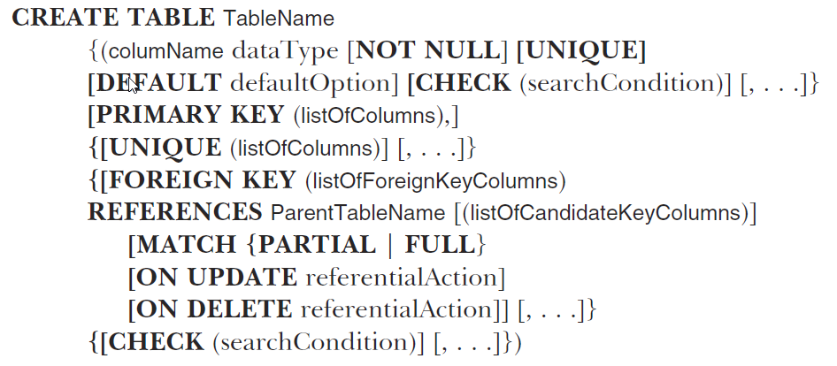
Creating Tables
General SQL syntax for creating a table:
Source: Connolly, 2015
[ ] : optional

Slide 9
CREATE TABLE
Creating a table without constraint.
CREATE TABLE tableName (
columnName dataType [ DEFAULT value ]
[, column2Name datatype [ DEFAULT value]]);
[ ] : optional

Slide 10
CREATE TABLE
Creating a table with constraints.
Constraints at column level.
CREATE TABLE tableName
(columnName dataType [CONSTRAINT constraintName] constraintType [DEFAULT value]
[, column2Name datatype [CONSTRAINT constraintName] constraintType [ DEFAULT value]]);
[ ] : optional

Slide 11
CREATE TABLE
Creating a table with constraints.
Constraints at table level.
CREATE TABLE tableName
(columnName dataType [DEFAULT value]
[, column2Name datatype[ DEFAULT value]]
[, CONSTRAINT constraintName constraintType (columnName,…)]);
[ ] : optional

Slide 12
Common Data Type
Common Data Type (in Oracle)
  Characters or String: CHAR(size), VARCHAR(size)
  Dates: DATE
  Numeric:
    Integer: INTEGER, NUMBER(p) 🡪p: precision
    Fixed number: NUMBER(p,s) 🡪 p: precision, s: scale
    Floating-number: NUMBER, FLOAT

Slide 13
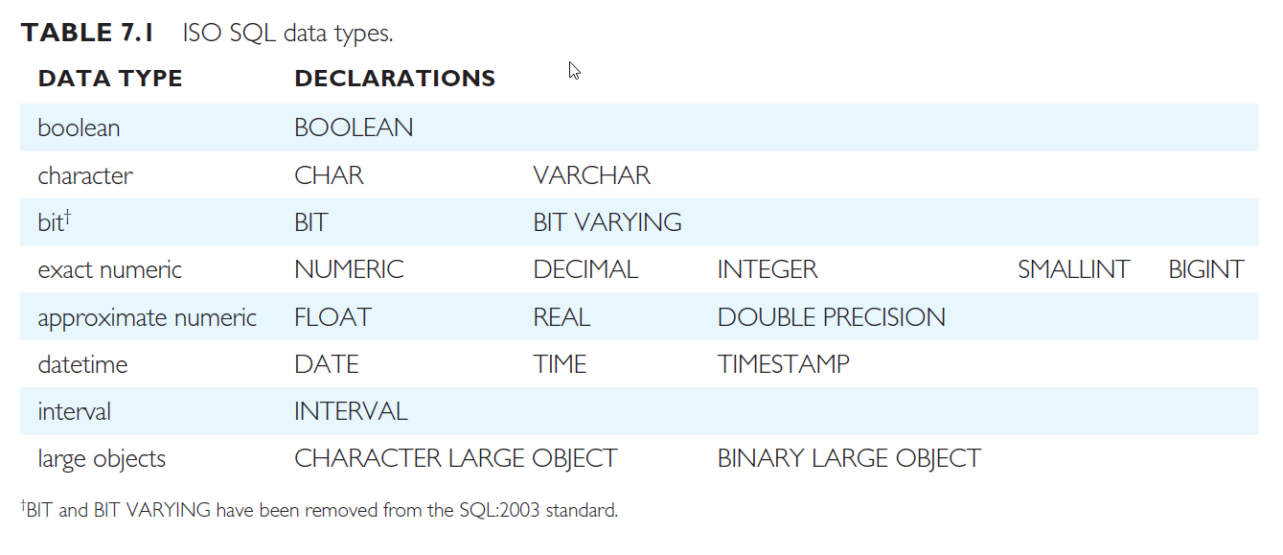
Common SQL Data Type
Overview
Source: Connolly, 2015

Slide 14
Constraints
Types of constraints:
  PRIMARY KEY
  FOREIGN KEY
  UNIQUE
    Ensure all data values stored in the column are unique.
    Differ from PRIMARY KEY since it allows NULL values.
  CHECK
    Checks a specific condition during the execution of the query.
  NOT NULL

Slide 15
Examples (CREATE TABLE)
Given the structure of the Department table as follows:
Department
Employees
Attribute | Datatype
deptNo (Primary Key) | Number – precision(5)
deptName – requires values | Varchar(20)
Address | Varchar(30)
City | Varchar(15)
Attribute | Datatype
empID (Primary Key) | Number
fName – requires values | Varchar(20)
lName – requires values | Varchar(30)
deptNo (Foreign key) – deptNo is an attribute in Department relation | Number(5)

Slide 16
Examples (CREATE TABLE)
Create table without constraint:
In this case, constraints (e.g.: primary key) can be added using ALTER TABLE command.
CREATE TABLE Department (
deptNo NUMBER(5),
deptName VARCHAR(20),
address VARCHAR(30),
city VARCHAR(15)
);
CREATE TABLE Employees (
empID NUMBER,
fName VARCHAR(10),
lName VARCHAR(20),
deptNo NUMBER(5)
);

Slide 17
Examples (CREATE TABLE)
Create table with constraints:
CREATE TABLE Department (
deptNo NUMBER(5) PRIMARY KEY,
deptName VARCHAR(20) NOT NULL,
address VARCHAR(30),
city VARCHAR(15)
);
CREATE TABLE Employees (
empID NUMBER PRIMARY KEY,
fName VARCHAR(10) NOT NULL,
lName VARCHAR(20) NOT NULL,
deptNo NUMBER(5) REFERENCES Department(deptNo)
);

Slide 18
Altering Tables
To change the structure of a table once it has been created.
General Syntax:
ALTER TABLE tableName
ADD columnName dataType );
Add new column
ALTER TABLE tableName
ADD CONSTRAINT constraintName constraintType(columnName);
Add new constraint
ALTER TABLE tableName
MODIFY columnName newdataType/size/defaultvalue;
Change data type, data size, default values, constraints
ALTER TABLE tableName
DROP COLUMN columnName;
Delete column

Slide 19
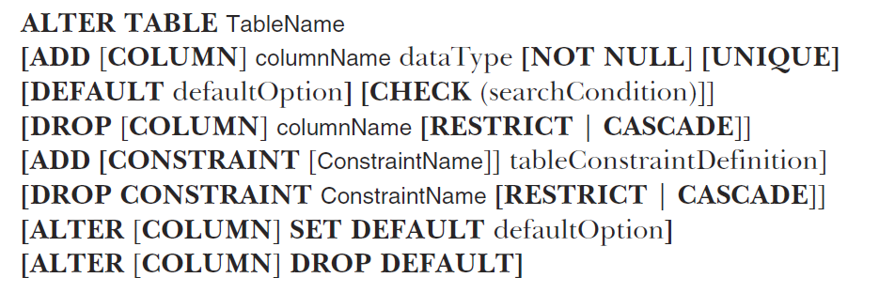
Altering Tables
General syntax for altering tables
Source: Connolly, 2015
[ ] : optional

Slide 20
ALTER TABLE - Examples
Add new column “Address” into Employee table.
Change datatype of “Address” to VARCHAR(20) and set the column as NOT NULL
Delete the column “Address”
ALTER TABLE Employee
ADD Address VARCHAR(40);
ALTER TABLE Employee
MODIFY Address VARCHAR(20) NOT NULL;
ALTER TABLE Employee
DROP COLUMN Address;

Slide 21
ALTER TABLE - Examples
Adding constraint after a table has been created.
Set the attribute of “EmployeeID” as the PRIMARY KEY for the Employee table.
ALTER TABLE Employee
ADD CONSTRAINT pk_Employee
PRIMARY KEY(EmployeeID);
Optional

Slide 22
Examples (ALTER TABLE)
If both tables are created without constraint.
Constraints must be added using ALTER TABLE
Department
Employees
Attribute | Datatype
deptNo (Primary Key) | Number – precision(5)
deptName – requires values | Varchar(20)
Address | Varchar(30)
City | Varchar(15)
Attribute | Datatype
empID (Primary Key) | Number
fName – requires values | Varchar(20)
lName – requires values | Varchar(30)
deptNo (Foreign key) – deptNo is an attribute in Department relation | Number(5)

Slide 23
Examples (ALTER TABLE)
For Department table, primary key and the NOT NULL constraint for deptName attribute
For Employees table, primary key, NOT NULL constraints and foreign key to be added.
ALTER TABLE Department
ADD CONSTRAINT pk_Department PRIMARY KEY(deptNo)
MODIFY deptName VARCHAR(20) NOT NULL;
ALTER TABLE Employees
MODIFY fName VARCHAR(20) NOT NULL
MODIFY lName VARCHAR(30) NOT NULL
ADD CONSTRAINT pk_Employees PRIMARY KEY(empID)
ADD CONSTRAINT fk_EmpDept FOREIGN KEY (deptNo) REFERENCES Department(deptNo);

Slide 24
Deleting Table
General Syntax:
Example: delete the table named “Employee”
DROP TABLE tableName;
DROP TABLE Employee;

Slide 25
Restore Dropped Table
Dropped tables are actually placed in a recycle bin and can be restored.
Syntax:
Supported only in Oracle.
FLASHBACK TABLE tableName TO BEFORE DROP;

Slide 26
Other Useful Statements
Viewing list of tables in a user schema:
USER_TABLES: oracle’s data dictionary object that stores information of tables created under a specific user (schema)
To view the list of tables:
Supported in Oracle.
SELECT TABLE_NAME FROM USER_TABLES;

Slide 27
Other Useful Statements
Viewing table structures using DESC or DESCRIBE.
  Syntax:
  Example: View the table structure of Employee table.
Rename a table using RENAME
  Syntax:
  Example: Rename the Employee table to “Workers”
DESCRIBE tableName;
DESCRIBE Employee;
RENAME tableName TO newtableName;
RENAME Employee TO Workers;

Slide 28
Other Useful Statements
Create table from existing database tables, using the AS clause and subqueries
Syntax:
Example: create a new table based on the HR Employee table in Oracle.
CREATE TABLE tableName [(columnName,…)]
AS (…subquery…);
CREATE TABLE NewEmployee
AS (SELECT * FROM hr.Employees);
Subquery

Slide 29
Exercise

